Slide 1

Design Patterns
Solutions to common problems in Software Design

Slide 2
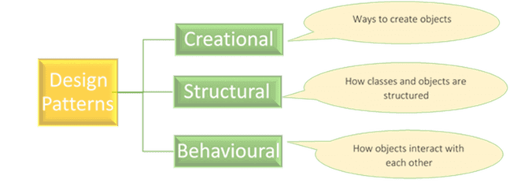
Types of Design Patterns

Slide 3
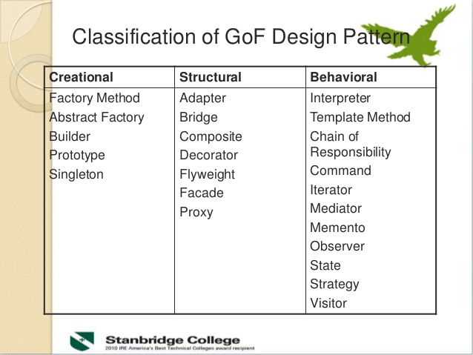
Classification

Slide 4
Facade Pattern

Slide 5
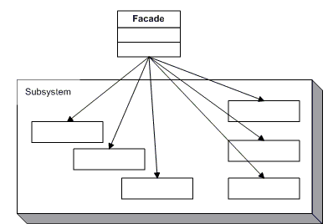
Facade Pattern
The façade pattern allows us to reduce the complexity of a system, by dividing it into subsystems, and additionally, it reduces the dependence of a client with respect to a certain component.
Ref: GOF Structural Patterns FACADE

Slide 6


Facade Pattern - Advantages / Disadvantage
Separating the client from the components of the subsystem reduces the number of objects with which the client references.
Promotes a weak coupling between the subsystem and its clients.
Several clients need to access different subsets of the functionality provided by the system , so, they could end using only a small part of the facade.

Slide 7
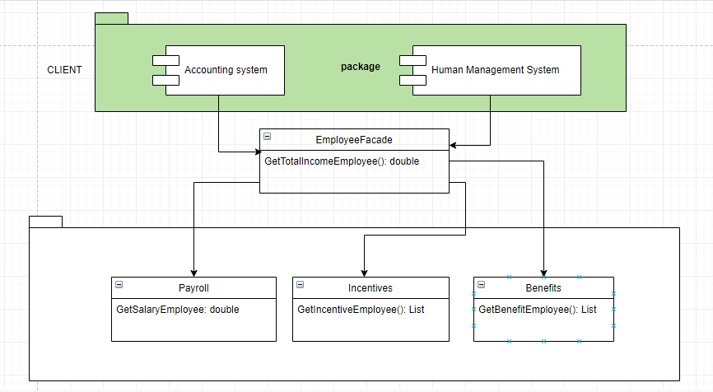
FACADE example

Slide 8
Adapter Pattern

Slide 9

Adapter Pattern
The Adapter design pattern is used when we have incompatible software interfaces, which, despite their incompatibility, have similar functionality. This pattern is implemented when you want to homogenize the way you work with these incompatible interfaces, for which you create an intermediate class that works like an adapter. This adapter class will provide the methods to interact with the incompatible interface

Slide 10

Adapter Pattern - Advantages / Disadvantage
It makes two incompatible interfaces be compatible. It can serve to encapsulate classes that we do not control, and that can change.
Integrate with external systems.
Design complexity.

Slide 11
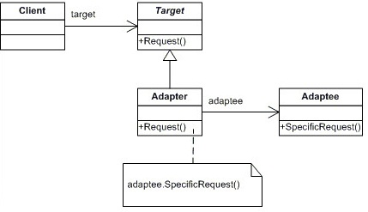
Adapter Class Diagram

Slide 12
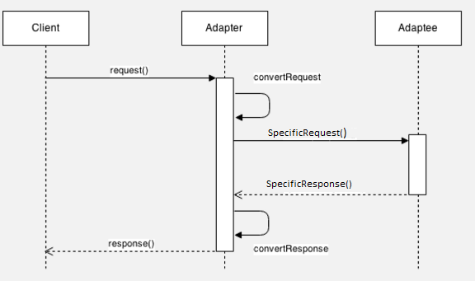
Adapter – Diagram of Sequence
The Client invokes the Adapter with generic parameters.
The Adapter converts the generic parameters into specific Adaptee parameters.
The Adapter invokes the Adaptee.
The Adaptee responds.
The Adapter converts the response of the Adaptee to a generic response for the Client.
The Adapter responds to the Client with a generic response.

Slide 13
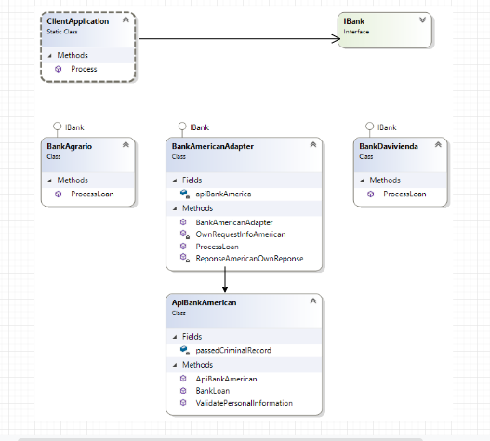
Adapter – Sample

Slide 14
Chain of Responsibility Pattern

Slide 15

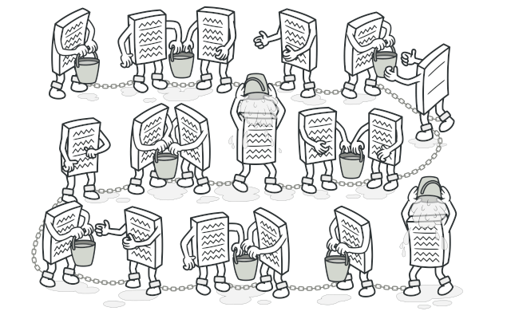
What is it?
Allows an object to send a command without knowing what object will receive and handle it. The request is sent from one object to another making them parts of a chain and each object in this chain can handle the command, pass it on or do both.

Slide 16

When to use it?
Decouple a request’s sender and receiver
Multiple objects, determined at runtime, are candidates to handle a request
The handler is not known in advance
specify handlers is not necessary
The object can be handle by one or more requests
It’s wished that the request is addressed to a group of objects without explicitly specifying its receiver

Slide 17

Advantage / Disadvantage
Advantage:
Reduce coupling
avoids attaching the sender of a request to its receiver, giving this way other objects the possibility of handling the request too.
Object doesn’t need to know the chain structure
The objects become parts of a chain and the request is sent from one object to another across the chain until one of the objects will handle it.
Enhance flexibility of object assigned duties (add, change or remove responsibilities throw the chain)

Slide 18

Advantage / Disadvantage
Disadvantage:
Easy to broke: if the developer doesn’t call the next handler the request can be lost on the way. (the execution is handled by subclasses instead of the super class)
some requests may end up unhandled due to the wrong implementation of concrete handler
Performance can be affected
Debugging is not easy to do because the implementation may cause cycle calls

Slide 19
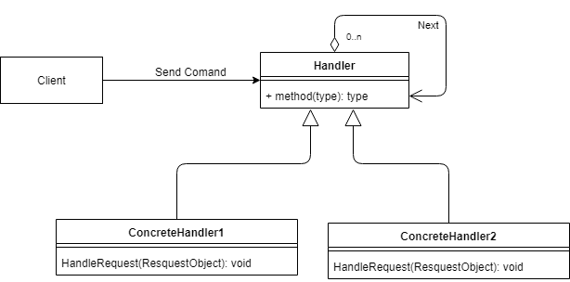
Class Diagram

Slide 20
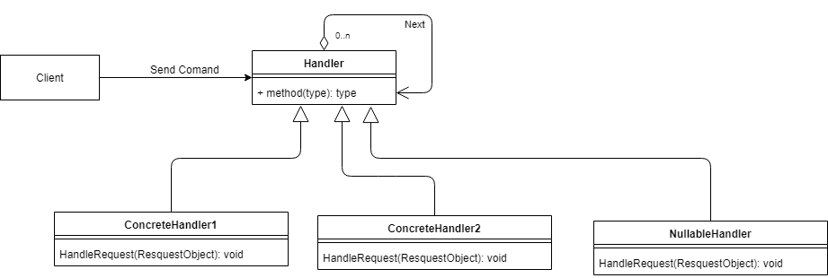
Chain of Responsibility + Nullable

Slide 21
Singleton Patterns

Slide 22
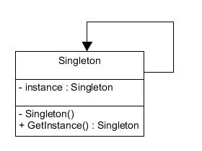
Singleton
Restricts instantiation of a class so that it only creates one instance of the class that implements it.

Slide 23
When to use it?
Application needs only one, instance of an object and global access are necessary.

Slide 24
Advantage / Disadvantage
Advantage:
Global state
The singleton class has the flexibility to change the instantiation process
The implementation is easy and can be transform to a pool instances handle

Slide 25
Advantage / Disadvantage
Disadvantage:
Someone calls it “antipattern”
Can violate the Single Responsibility
Not always is thread safe

Slide 26
CONCLUSIONS

Slide 27
Patterns and SOLID principles are focused on high cohesion and low coupling
Increase maintainability and quality code
You'll better developer
Create code that can be use by more than one module (avoid duplicate code)
Patterns solve common problems

